Slide 1
Tournament Ranking System
EECE 2560: Fundamentals of Engineering Algorithms
Lucas Confalonieri, Ben Wu, Cameron Whiting

Slide 2
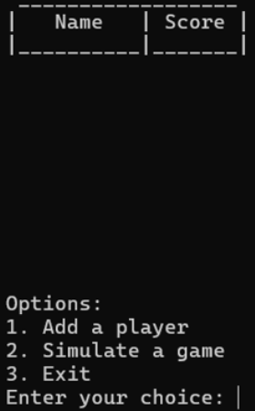
Objective
Create an online tournament ranking system in C++
Utilize data structures like linked lists that were discussed in class
Create and implement a sorting algorithm to rank players
Develop a UI in the command line to display information and interact with the user

Slide 3
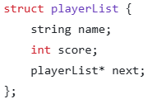
Methodology (Linked List Structure)
Started with singly linked list data structure
Merge sort does not rely on backtracking so no need for doubly linked list
Uses a string "name" to identify a unique player
Includes an integer "score" to keep track of player
Score increases by 1 with a win and decreases by 1 for a loss
Score will never drop below zero
Each data structure is linked to the next with a "next" pointer variable

Slide 4
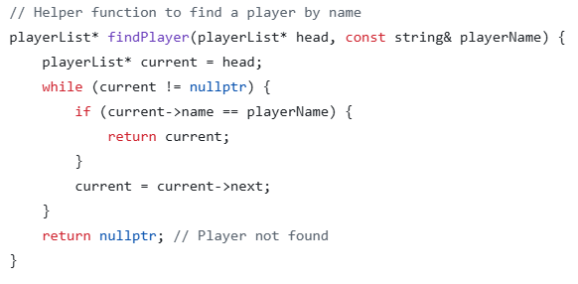
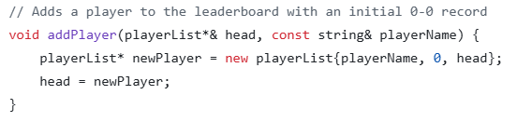
Methodology (Linked List Functions)
Helper functions are used to iterate through and add players to the list
Add player adds a new node to the end of the list
Find player returns the node with the name given

Slide 5
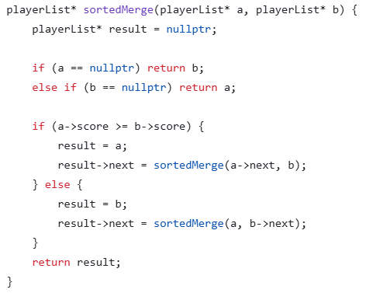
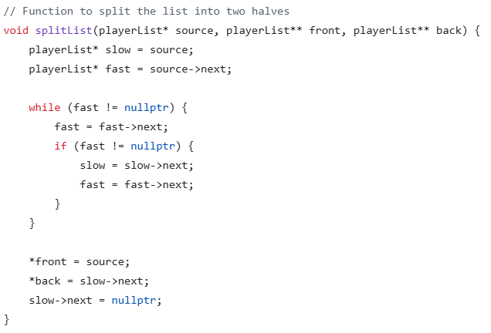
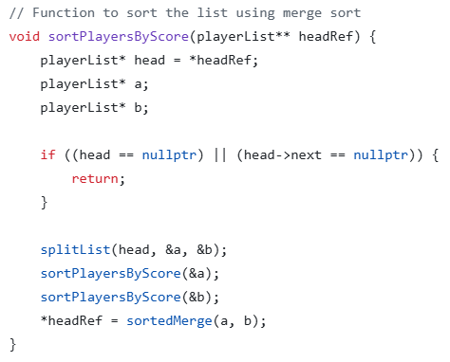
Methodology (Merge Sort)
Merge sort splits the list into two lists and repeats that recursively until each list has only one element in each
Then by comparing pairs of elements, they are sort
Then each smaller list is merged into each other recursively while being sorted
It returns the list fully sorted in O(nlogn) time

Slide 6
Demonstration

Slide 7
Analysis and Results
Product
Successfully implemented the merge sort algorithm
Created a UI in the C++ terminal
Enabled an auto-updating leaderboard system
Team results
Conducted weekly meeting where we would review pull requests and set new goals
Got a much better understanding of how a group collaborates with GitHub
Split work based on strengths to efficiently complete tasks

Slide 8
Discussion
Project limitations
Couldn’t write a real UI in C++ as no built-in libraries
Didn’t have time to implement a more compelling game
Implications
Learned how to build and utilize a merge sort algorithm
Learned how to use more complex commands in the command line

Slide 9
Conclusion
Recommendations for the future
Implement players with differing skillset to mimic a real competition
Implement a real game to play (such as chess)
Add Elo rating to each player (Changes dynamically)

